Slide 1
April 27th Clean Air Council Meeting
Upcoming 2018 CAC Meetings
Funding Opportunities Discussion
Climate Change Messaging Workshop

Slide 2
The Red Thread of Persuasion
Tamsen Webster: The Red Thread framework provide a pathway to guide people in creating concise and effective way to develop communication in a way that instigates change.
How we put words together, even if they are the same words, makes a difference for how effective those words are getting the desired goal we desire.
Words are how we capture and share the data that we have.
We are surrounded by more information than any other people on earth at any time.
Is it any wonder we are overwhelmed and have to be very selective to what we pay attention to?!

Slide 3
The Right Content
The right content is content that drives people to change and action.
What drives a person to decide to act?
Maximize reward/minimize risk
Action is preceded by belief – you have to believe something to be true in order to decide to participate in it
What precedes belief? Knowledge precedes belief.
You also have to feel you are capable of making that change or undertaking that action
You have to feel your action is actually going to make a difference
Solve climate change (do you feel capable of doing that?)

Slide 4
DO – BELIEVE - KNOW
We normally start from what we want people to know and then you have no idea if you have given them what they need to believe in order to motivate action.
However if we start from what we want people to do then we are in a better position to figure out and tell them what we want them to know.
Knowledge change beliefs, without belief, change doesn’t happen
Work Action Back – Not Goal Out

Slide 5
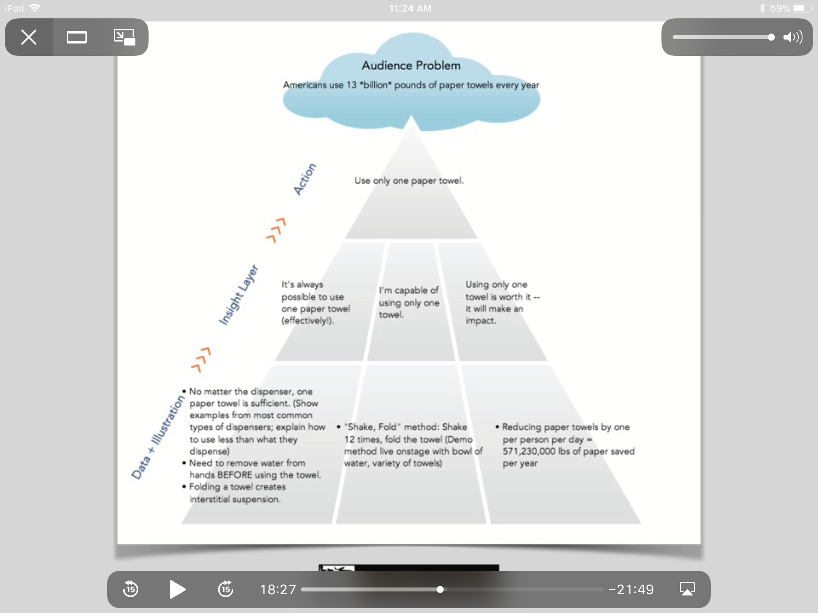
A Whole New Way to Look at Paper Towels

Slide 6
What do I want people to believe in order for them to do the action?
How can we make them believe they can do it?
How do we make them believe that them doing it will make a difference?
Now what do they need to know?
People’s brains require context
Context needs to be provided in the right sequence
And it needs to address the barriers/questions that come up in their head as your message is being shared with them

Slide 7
Helping to define their goal (not yours)
I’m for (category of people)
Who want (X)
Value (Y)
But struggle with (Z)
The narrower the focus the broader the reach
Why? Is it important? Why should they care? Why hasn’t this already happened?
What’s the problem? What does it mean to them? What’s standing in the way of solving this problem ? What do you want them to know?

Slide 8
Ponder this….
What do you want them to do? (higher level want)
How do you want them to do it?
More specific actions and how can they act on this?
In order for our brains to process an idea it needs to see the connections to an irresistible outcome before it will continue listening
What do they want?
What do they struggle with?
What do they value?

Slide 9
Context
Who are you for?
What do you want them to know?
What do want them to do?
Comprehension comes from asking questions….
There is always a dialogue happening whether it is out loud or just in people’s head.
If you aren’t answering the questions that are going through their head, you wont be able to attain their belief.
Always ask yourself: if I say this what's the question that is likely to be in the audience’s head?

Slide 10
Red Thread Path
Goal Problem
Problem Idea
Idea Change
Change Action
Introduction and Conclusion (do at the end) It’s the wrapping
Demonstration and Engagement ideally

Slide 11
Goal – WHAT THEY WANT (NOT WHAT YOU WANT)
Problem – WHY HASN’T THIS BEEN SOLVED ALREADY AND WHY IS IT SO IMPORTANT TO SOLVE IT, WHATS IN IT FOR THEM
Idea –WHAT MAKES INACTION IMPOSSIBLE FOR THEM
Change –WHAT THEY MUST DO
Actions – HOW THEY DO IT

Slide 13
Goal
What is the change you want to effect in or with them? What do you want them to think or do differently as a result of the talk?
This is your goal for the talk – the thing you want to achieve.
What's the ONE thing the audience is trying to achieve that you believe this talk will ultimately help with? This is the GOAL.
Hint its not ghg reductions. That is your goal not theirs.
Ask yourself if I were to say that goal would it readily get a YES from them? Unless you can easily answer yes to that keep working on it.

Slide 14
Problem
what do you see as the single, underlying barrier to the audience's goal? This is the PROBLEM your talk will solve.
It makes achieving the goal personally worth it…and the pursuit of the goal a lot more interesting. The audience may or may not know they have this "real" problem, but it summarizes all the barriers the audience does see.
Establish the problem by asking yourself the real reason that goal hasn’t been achieved.
It cant just be things they already know
Describe the world in a new light for them, make them see something old in a new way.
Contrast with where they are now and where they want to be

Slide 15
Idea
What is the ONE thing your ideal audience member must understand (but probably doesn’t) to solve the problem. This is the IDEA.
This MUST be present.
The idea unlocks why the problem exists, and is the key to why the change you're looking for is the right one.
The idea can be captured by figuring out what the link is between the goal and the problem?
The key idea that is both the diagnosis of the problem (why this problem is so important) but also dictates the change.
The ideal idea is one that makes ignoring the problem impossible

Slide 16
Change
what is the single, high-level change the audience needs to solve the problem and achieve their goal? This is the CHANGE. This is what any actions you're asking the audience to take all boil down to.
And note: "understand" isn't a change...it's a step to a change
Common mistake – people focus on the action rather than the change
Change defines the intent that guides action
a shift in behavior from you’re your audience started
Make sure it is not just a reverse of the problem
It’s the problem, plus the idea, that results in the change

Slide 17
Action
what ACTION, or multiple ones, can the audience take to enact the change. If you have more than five, "chunk" them into a smaller number of categories.
Make sure that all the specific actions can all be summarized by the change that you are recommending (not the place to add in actions that aren’t linked to the change)

Slide 18
STRUCTURE the talk at a high-level by stringing the five sentences together:
Goal, Problem, Idea, Change, Action
STRUCTURE the talk at a detailed level by filling in the concepts you need to move the audience from one sentence to another. Use these five concepts as the beginning and endpoints of three basic sections of your talk, and gather all the concepts, stories, examples, and information you need for each section:
Section 1: Since the audience already agrees with the GOAL, what do they need to know to agree with the PROBLEM?
Section 2: Now that they agree with PROBLEM, what do they need to know to agree with the IDEA?
Section 3: Now that they agree with IDEA, what do they need to know to agree with the CHANGE and take ACTION?

Slide 19
Red Thread Mad Libs
We can all agree that we want (GOAL)
But the real problem is (PROBLEM)
To solve this problem we have to understand (IDEA)
Which mean that we have to (CHANGE)
How? (ACTION)
For each concept identify the examples, stories, data, metaphors, demonstrations you will use to support it.

Slide 21
Section 2
Section 3
Section 1

Slide 23
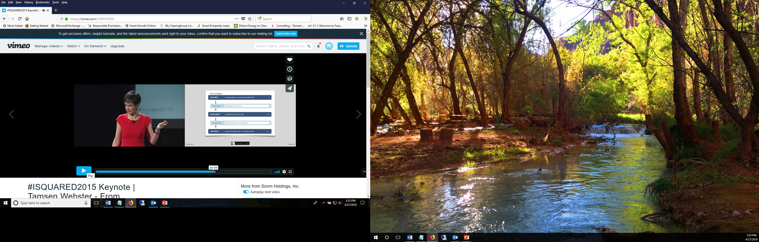
Within Each Section
Within each section of the communication pathway – there is a structure to guide your INSIGHTS and TRANSITIONS

Slide 24
Conclusion
Hook it together for them (audience perspective again – not yours)
Goal: what is it that they want?
Problem – What’s getting in the way of getting what they want and why do they want it
Idea – what have you provided them to understand this more deeply
Change – what can they do to act on that new understanding
Action – How do they make that change actually happen
One sentence for each of those is your conclusion
Hooks and emotion draws

Slide 25
Recommended Links and Videos
Tamsen Webster Web site
How to Bridge a Mental Gap
Tamsen Webster - From Keynote to Keyboard: What TED Can Teach Us About Content Creation
What is the Red Thread
Focus on the GOAL: Why Your Audience Needs an "Irresistible Outcome“
Focus on the GOAL - Putting the "Feel" in "Think, Feel, Do"
Focus on the PROBLEM - Why Your Audience Needs Both Context and Contrast
Focus on the IDEA - The Difference Between "Understandable" and "Inevitable“
Focus on the CHANGE - Defining the Intent That Guides Action
Focus on the ACTION - How to Make the Change Actually Happen
The 5 Most Common Red Thread Mistakes
The Biggest Mistake You Can Make in Your Conclusion... and How to Avoid It

